Slide 1
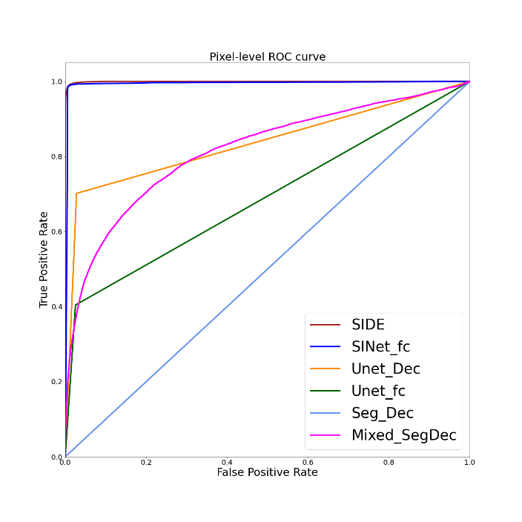
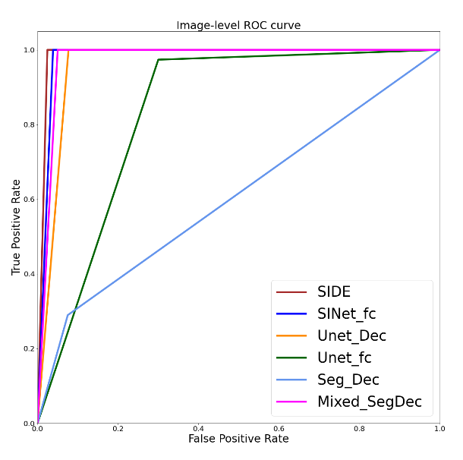
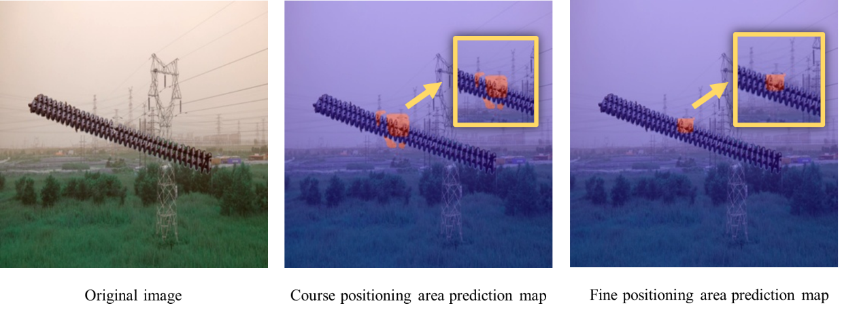
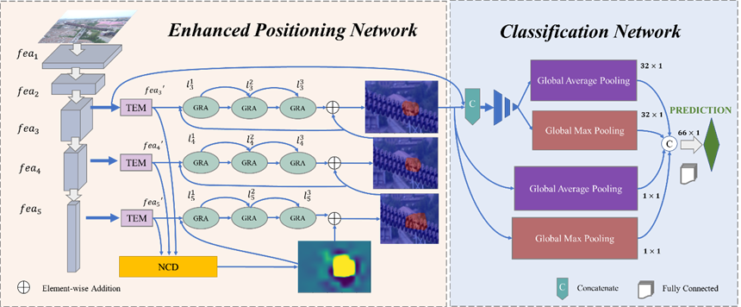
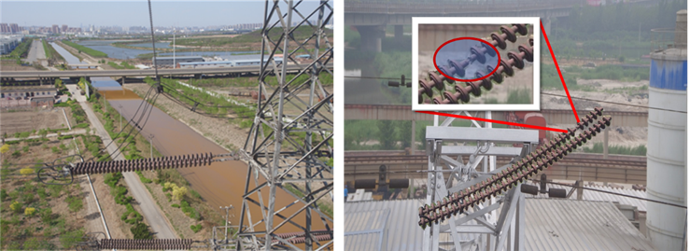
2024 3rd International Symposium on Sensor Technology and Control (ISSTC 2024)
Title: XXXXXXXXXXXXXXXXXXXXXXXXX
XXª, XXXª, XXX^{b},
a. School of electrical and automation, Wuhan University, Wuhan 430072,China
b. School of electronic and electrical engineering, Wuhan Textile University, Wuhan 430200, China
INTRODUCTION
XXXXXXXXXXXXXXXXXXXXXXXXXXXXXXXX.
Table 1XXXXXXXXXXXX
Model | AUC | IoU | accuracy | F1-score | precision | recall | FPS
PROBLEMS
XXXXXXXXXXXXXXXXXXXXXXXXXXXXXXXXX.
Fig. 3 XXXXXXXXXXXXXXXXXXXXXXXXXXXXXXXXXXXXXXXXXXXXXXXX
METHODS
Process Visualization
XXXXXXXXXXXXXXXXXXXXXXXXXXXXXXXXX.
Fig.XXXXXXXXXX
CONCLUSIONS
XXXXXXXXXXXXXXXXXXXXXXXXXXXXXXXXX.
Fig.1 XXXXXXXXXXXXXXX
XXXXXXXXXXXXXXXXXXXXXXXXXXXXXXX.
RESULTS
XXXXX
ACKNOWLEDGEMENT
Fig. 2 XXXXX
XXXXXXXXXXXXXXXXXXXXXXXXXXXXXXXXX.

Slide 2
备注：
海报为A1尺寸，模板如上所示，具体请根据论文实际情况调整，编辑好海报内容后，请删除本页备注，并导出第一页幻灯片为PDF或图片格式后上传到参会报名系统附件，亦可直接将PDF发给对接的会务组老师。

