Slide 1
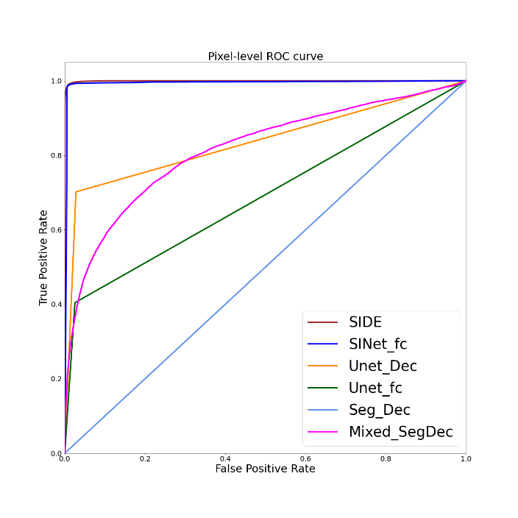
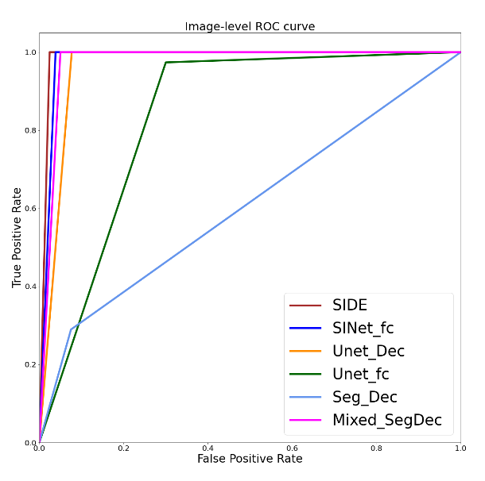
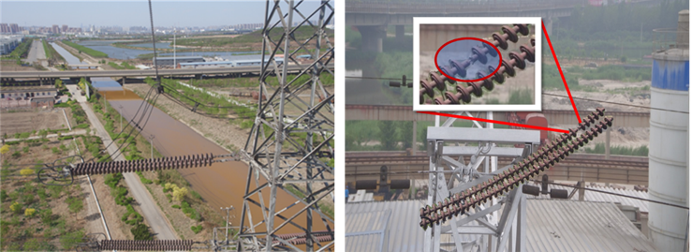
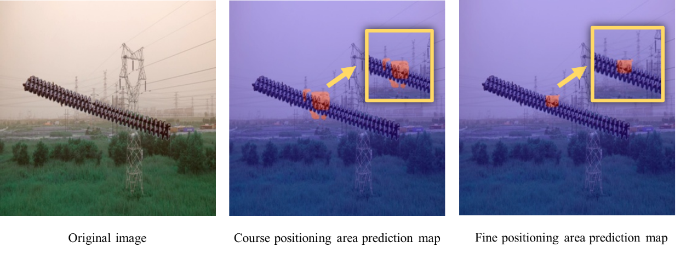
2025 8th International Conference on Advanced Electronic Materials, Computers and Software Engineering (AEMCSE2025)
Title: XXXXXXXXXXXXXXXXXXXXXXXXX
XXª, XXXª, XXX^{b},
a. School of electrical and automation, Wuhan University, Wuhan 430072,China
b. School of electronic and electrical engineering, Wuhan Textile University, Wuhan 430200, China
INTRODUCTION
XXXXXXXXXXXXXXXXXXXXXXXXXXXXXXXX.
Table 1XXXXXXXXXXXX
Model | AUC | IoU | accuracy | F1-score | precision | recall | FPS
PROBLEMS
XXXXXXXXXXXXXXXXXXXXXXXXXXXXXXXXX.
METHODS
Fig. 3 XXXXXXXXXXXXXXXXXXXXXXXXXXXXXXXXXXXXXXXXXXXXXXXX
XXXXXXXXXXXXXXXXXXXXXXXXXXXXXXXXX.
Process Visualization
Fig. 2 XXXXX
Fig.XXXXXXXXXX
CONCLUSIONS
XXXXXXXXXXXXXXXXXXXXXXXXXXXXXXXXX.
RESULTS
XXXXX

Slide 2
Note/备注
海报为A1尺寸，模板仅供参考，具体内容请根据论文实际情况调整。
最后请删除本页备注，并将海报导出为JPG格式后发送到会议邮箱或直接发给会务组老师。
海报命名方式（姓名+单位+论文订单号+参会形式）
The poster is A1 size and the template is for reference only. Please adjust it according to the actual situation of the paper. After editing the poster content, please delete the notes on this page and convert the first page slides to PDF or image format and send it to the conference Email, or send the Poster to the corresponding conference secretary.
Poster naming ( You name+Paper number)

